Slide 1
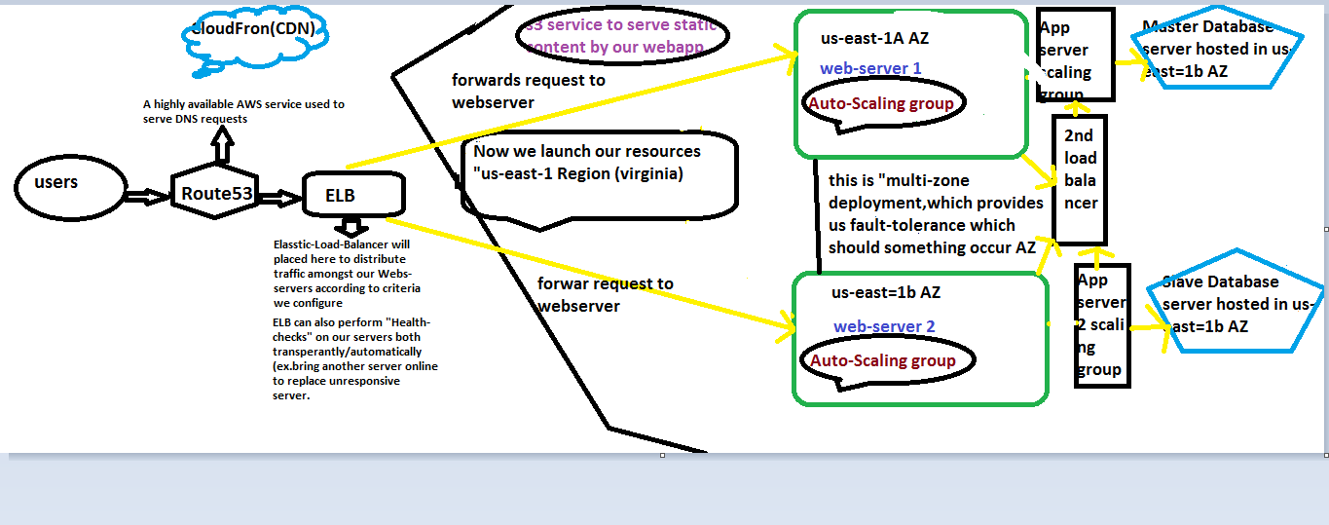
AWS 3 TIER ARCHITECTURE

Slide 2
AWS 3 TIER ARCHITECTURE
1)Auto-Scaling Group :-It allows us to do scale our resource up and down automatically as need,according parameters we set during configuration of the group.we can configure both a minimum number of compute resource within our Auto-scaling Group.
2)launch-Configuration:- we need select AMI.
3).cloud-watch Alarm:- to check system metrics like cpu/mem utilization.if there is any issues in compute services then it will send alarm and re-send the request to available instance.
s3:we can use this service to serve static content to our webapplication.This we can place it in outside AZ and Regions why because AWS s3 is a global service not a region or AZ,as it spans all Regions & AZs.

Slide 3
How to setup secure VPC|Network ACL vs Security-Groups.
Components to setup VPC:-
CIDR:CLASSLESS INTER DOMAIN ROUTING
AWS SUPPORTS “more than/16, below/28” MINIMUM SUBNETS.
By default AWS will create one route table ,newly created subnet will be integrated with that route table.
We can create network ACL and place it on the top of subnets.

Slide 4
How to setup secure VPC|Network ACL vs Security-Groups.
Security groups is available for port filterate.
We can deny/allow any port which is not accessible and which is accessible.
Private subnets:-The subnets which is not connected to routing table and routes to internet gateway.
Public subnets:- the subnets which is connected to routing table and routes to internet gateway.

Slide 5
How to setup secure VPC|Network ACL vs Security-Groups.
NAT:- The private subnets which is access to internet.
IAM Roles and policies which is used to provide security.
If we want to connect client laptop we can enable “site-to-site vpn enable.
If we want to connect AWS from corporate data center :-

Slide 6
How to setup secure VPC|Network ACL vs Security-Groups.
1.enable vpn
First we need configure “virtual-private-gateway”,that gateway configure aws account.
2.customer gateway.
Here where we define public ip address should be shared based on vpn connection is enabled.
Remember:- if we want to connect corporate datacenter to aws .

Slide 7
How to setup secure VPC|Network ACL vs Security-Groups.
Customer gataway configure on-premised datacenter
Virtual private gateway(vpg) should be configured on AWS side.
End-user wants to connect directly connect to servers available in AWS.create one ec2 machine, this machine create public ip and private ip.

Slide 8
How to setup secure VPC|Network ACL vs Security-Groups.
Enable port 22.
We can called that server “jump-server or bastian hosts.
VPC-peering:-want to connect one vpc to another vpc different region.

Slide 9
Hybrid Cloud site Architectures
We can also design a hybrid cloud arfhityecture where servers in a cloud can communicate with dedicated servers that are hosted in an internal/external datacenter.
The multi-cloud architecture gives us the flexibility of primarly hosting your application in your private cloud but also auto-scale out into public cloud for additional server capacity, if necessary.

Slide 10
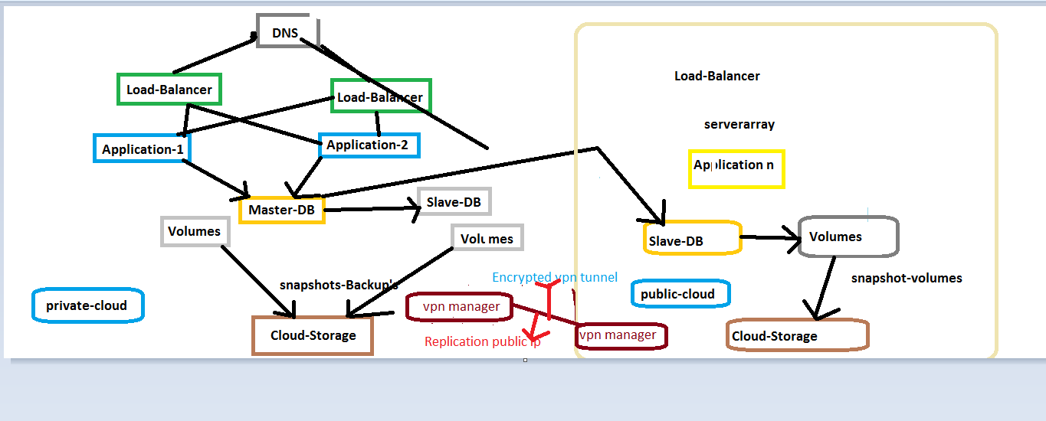
2

Slide 11
3
When we are designing our cloud system architecture across multiple clouds,there are several factor takes into consideration.
In the above diagram there is running slave-db server that’s serving warm backup but its replica data with the Master-DB across the public not in private ip.
Remember only servers with in the cloud same cloud infrastructure can communicate over private ip address.However if there is a problem or failure that would require you to switch clouds.

Slide 12
4
Multi-Cloud Architecute would allow easily migrate our site/Application.
If we want to send /receive data in a secure manner between servers in two different clouds,we can use data encryption or a VPN Wrapped around the public ip address.(expect if they are both private clouds).
In the above diagram data replication across the public internet is sent between the servers in two different clouds over a secure ‘vpn tunnel”.

Slide 13
5 Multi-cloud disaster Recovery
If there is a sudden outage at Data-center like power-issues,cooling issues,hardware issues etc.production environment is currently deployed.
If we launched the server templates,we will be able to use those same Server-Template (AMI-BACKUP’S) we can rebuild the our production environment by launching our servers into different cloud regions.
However we can manually take “LVM-Backup’s” of the database to supported cloud storage service.(Ex.remote object storage(ros).
If we perform database database migration or there is a cloud outage we can use “LVM-Backup’s” to relaunch our database server into a different cloud.

Slide 14
Hybrid Cloud Infrastructure Using Open VPN
Install Open VPN Server (AWS Linux AMI)
Yum install –y https://d1.fedorapr
Yum –y install yum-utils
Yum –config-manager --enable epel
Yum -y install openvpn
Server Configurations – server.conf
Server.conf

Slide 15
7
Ccd/client
Iroute [your client subnet]
Client Configurations – client.conf
Firewalls – Server
Enable ipv4 Forwarding – changes to /etc/sysctl.conf
Net.ipv4.ip_forwar = 1

Slide 16
Migrate onpremise workload to EC2
Tools Require:-
1.Snowball (supports TB/PB migration scale)
They are not look at the data,they just download the data.Data will be encrypted format even Amazon cannot see our data.This is completely secure way to move data from one datacenter to another with lot of data.
2. s3 Acceleration:-its gui, to push the data by using vpn.

Slide 17
8
3.kinesis Firehose:-we can configure kinesis firehose one end and store the all the data in s3 and push the data from source to destination.
4.Storage-Gatway:-It the most easiest way.setup vpn on client side or datacenter ,allow simple vm to clone the data from your on-premise datacenter storage amazon s3 or EBS or EFS volumes.
5.provisoned vm and provisoned Bandwidth all the data gets replicated to cloud.

Slide 18
9
6.we can contact third party vendor who are expert in data migration.
7.Direct-Connect, Amazon provides 1gbps to 10 gbps connection,this will connect to point-point or multiple direct connects to our data-center.
8.last option
We can select Ec2 instance or any third party open source client on cloud and setup vpn between corporate network and aws network and push all the data through the vpn-client.this is not efficient way but it easient possible manner.

